Slide 1

Customer Churn Prediction
Subject Code: SE326
Subject Name: Machine Learning
Branch: Software Engineering
Year: 2nd Year/4th Semester
Submitted by:
Amriti Gupta(2K21/SE/29)
Apara Maity(2K21/SE/36)
Submitted to:
Ms. Shweta Meena
Assistant Professor
Department of Software Engineering
Delhi Technological University

Slide 2
INTRODUCTION

Slide 3
Customer Churn prediction is predicting which customers are at high risk of leaving a company or canceling a subscription to a service, based on their behavior with your product.
To predict churn, you'll need to historical customer data at the ready, including: Demographics. Behavioral data. Revenue and subscription data (like subscription date, plan or pricing tier, MRR at the individual customer level, etc.)
Customer churn is a common problem across businesses in many sectors. If you want to grow as a company, you have to invest in acquiring new clients. Every time a client leaves, it represents a significant investment lost. Both time and effort need to be channelled into replacing them. Being able to predict when a client is likely to leave, and offer them incentives to stay, can offer huge savings to a business.
It is a supervised learning algorithm that gives equal weightage to all the independent variables that contribute to evaluating the probability.

Slide 4
DATASET
This data set contains details of a bank's customers and the target variable is a binary variable reflecting the fact whether the customer left the bank (closed his account) or he continues to be a customer.
Describing each column feature
RowNumber: Row number for the row in the data table.
CustomerId: Unique Identification number of the customer.
Surname: Surname (Last name) of the customer.
CreditScore: Credit Score of the customer.
Geography: Geographical location (country) of the customer.
Gender: Gender of the customer (Male / Female).
Age: Age of the customer.
Tenure: Number of years the customers has been associated with the bank.
Balance: The amount of balance in the customer's account.
NumOfProducts:
HasCrCard: Denotes if the customer owns a credit card with the bank.
IsActiveMember: Denotes if the customer is active with the bank.
EstimatedSalary: Estimated salary of the customer.
Exited: Denotes if the customer has churned (exited) from the bank or not.
https://www.kaggle.com/datasets/shrutimechlearn/churn-modelling

Slide 5
ETL & Exploratory Data Analysis

Slide 6
ETL
Kaggle Dataset → very clean
Dealing with NULL or missing data(Surprisingly, we do not find any NULL or missing values in this data. This is really good for our analysis)
.Removing features not needed for ML:
1..RowNumber
2.CustomerID
3.Surname
Extract, Transform, Load

Slide 7
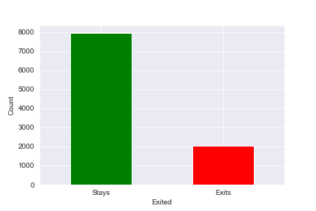
Target Feature Distribution
Imbalanced dataset:
Stays - 79.63%
Exits - 20.37%

Slide 8
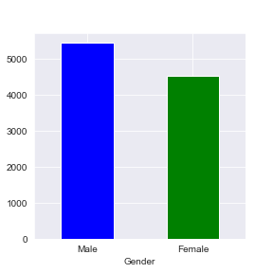
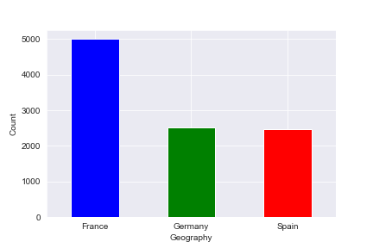
Distributions of Categorical Features
More males than females
France 50%; Spain, Germany 25% each

Slide 9
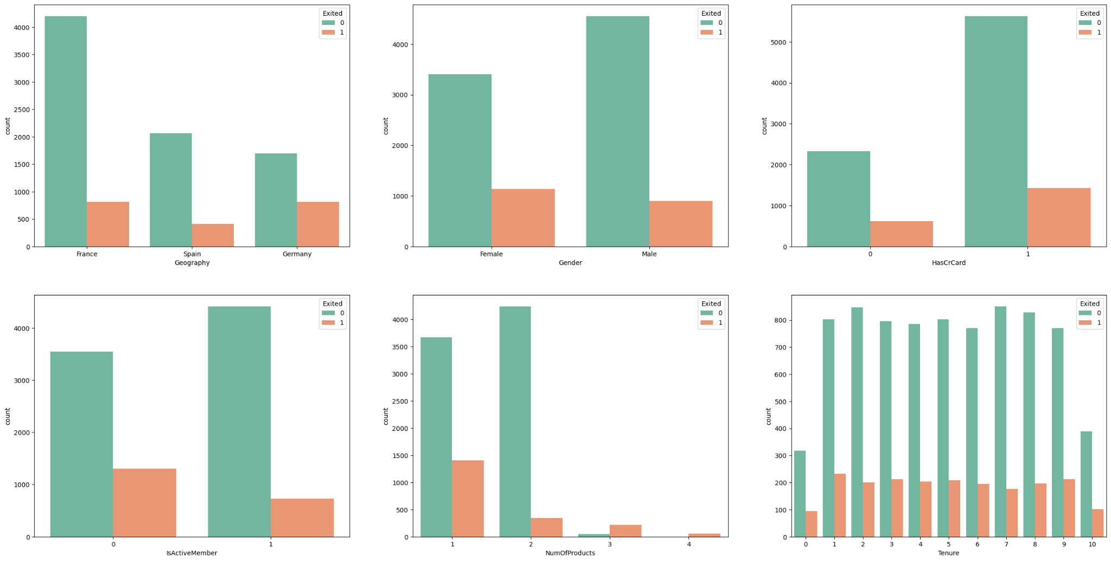
Distributions of Categorical Features

Slide 10
Distributions of Categorical Features
Observations
Geography: We can see that majority of the data is about people France. Ideally for an evenly-distributed data, if the amount of people from a place is the majority, then the majority of churning should also be within that group. However, it is not so in this case as we see that number of exited people who belong to Germany is almost equal to the number of exits from France.
Gender: We can clearly see the Female customers had more exits than the male customers.
Credit cards: It is generally expected that people who have more interactions and products of the bank, would likely be retained for a longer time. However, we can see that people who have credit cards have more exits than those who do not own credit cards.
Active Member: This is an expected observation. We can see that inactive members have been churned more than members who are active.
Number of Products: This is also an expected observation, where we see that customers who own more products from the bank are likely to be retained for a longer time than those who own less products.
Tenure: We see that the tenure of a customer does not really tell us much if that customer is likely to be churned or not. Initially, it looks like new joinees and older people (10 years) have been churned less. However, on a closer analysis we can see that the overall number of retained customer are significantly less in both these cases. As a result, we can probably conclude that new joinees and older customers may be more likely to be churned as their churn rate (percentage) is likely to be higher than other tenure rates.

Slide 11
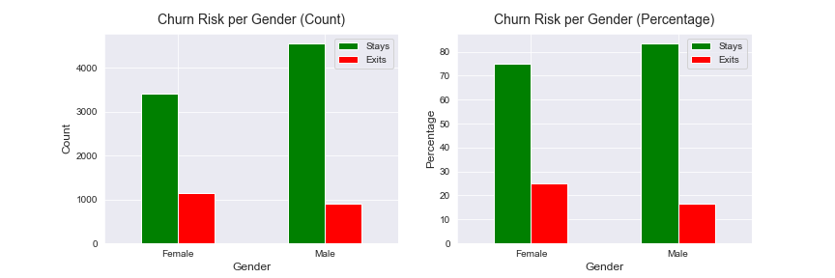
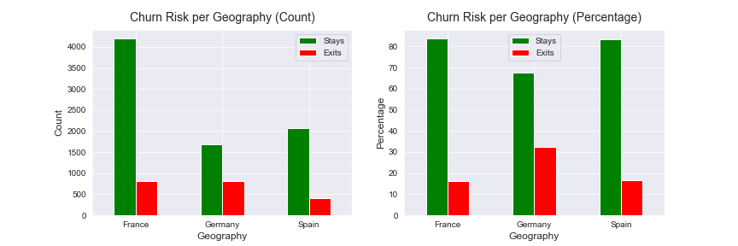
Churn Segmentation by Gender/Geography
Leaving bank:
females 25%
males 16%
1 of 3 German customers
Germany: least customers → most churn

Slide 12
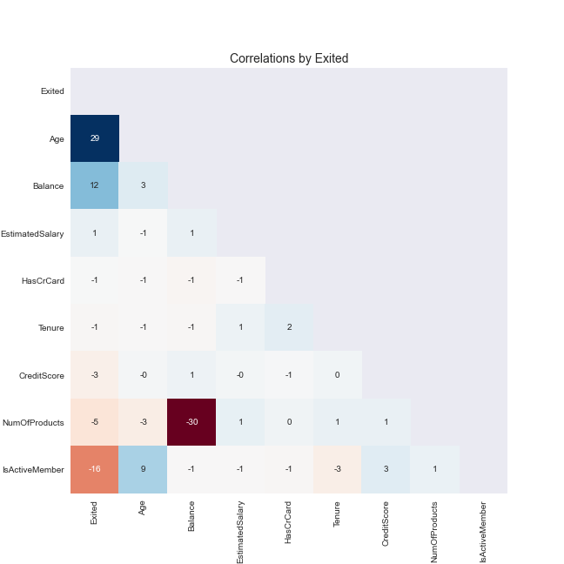
Correlations
Credit Score: We can see that Credit Score does not have much effect on the customer churn.
Age: Here we can see that the older customers are more likely to be churned from the bank. This is most probably to keep a younger manpower in the organization.
Balance: When it comes to Balance, we see that the bank is losing a significant number of customers with high balance in their accounts. This is likely to affect the bank's capital as well.
Estimated Salary: Estimated Salary does not seem to affect the customer churn much.
Number of Products: We see that the number of products also does not seem to affect the customer churn.
Tenure: For tenure, as we can see here too, customer belonging more to the two extreme tenure groups (new joinees and older ones) are more likely to be churned.

Slide 13
Machine Learning Modelling

Slide 14
Used Models
Logistic Regression
Support Vector Machines (SVM) with different kernel methods
1.RBF kernel
2.Poly kernel
Random Forest Classifier

Slide 15
Model Training Steps
load dataset
features - target variable split
train - test split
fitting the best models
visualizations of machine learning classifiers
choosing the best model
use model on test set
Apply SMOTE and generate new train & test set
Repeat above steps again

Slide 16
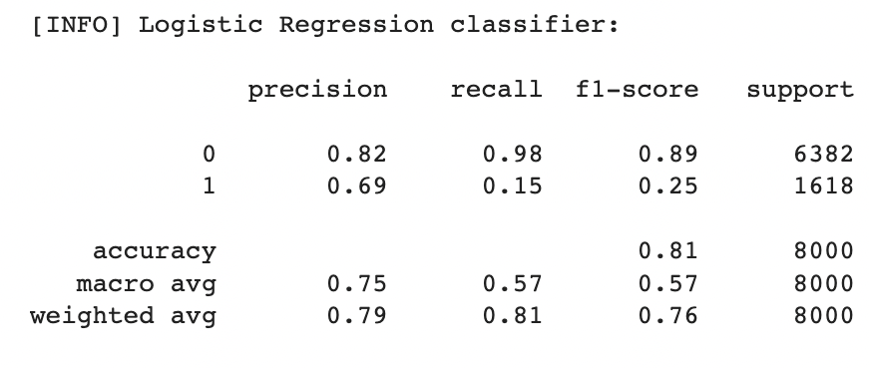
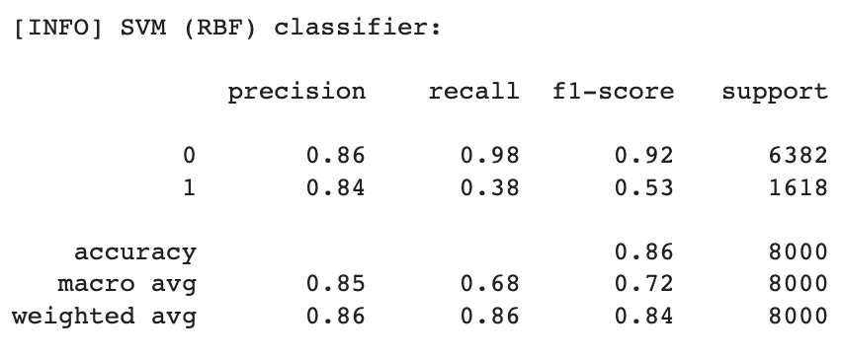
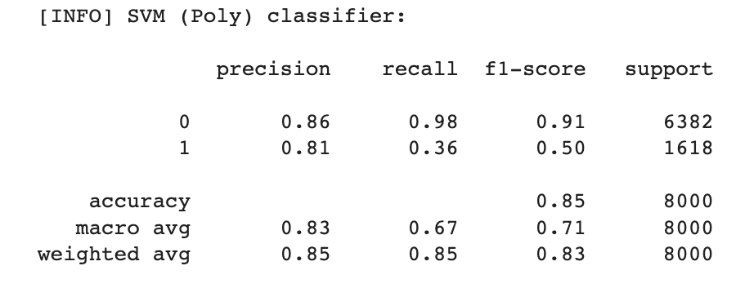
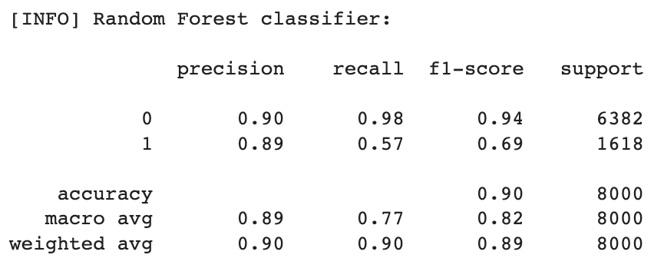
Classification Reports on Train Set

Slide 17
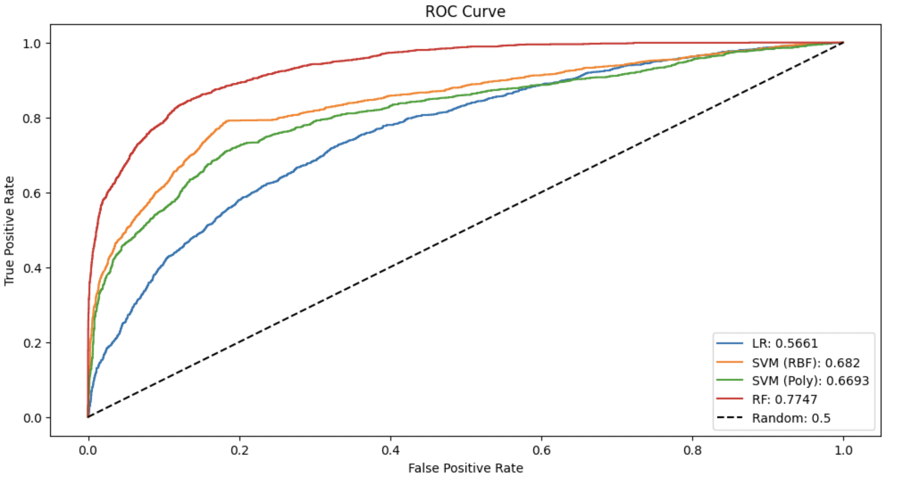
ROC Curve and Observation
From the above graph, we can clearly see that the Random Forest (RF) classifier has the highest ROC score (0.7733) and hence covers the highest area under curve as well. From this, we finally choose the Random Forest classifier with its optimal parameters as our final machine learning classifier model. Let us now try to use this model with our test data and see how it works out.

Slide 18
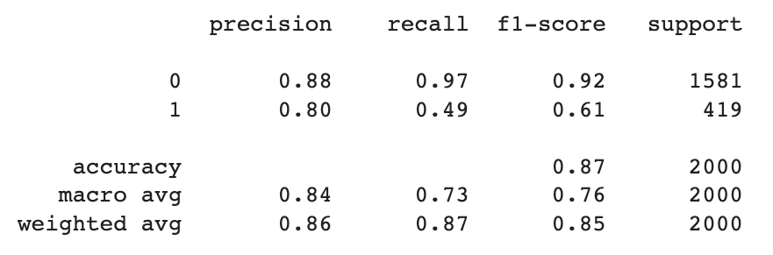
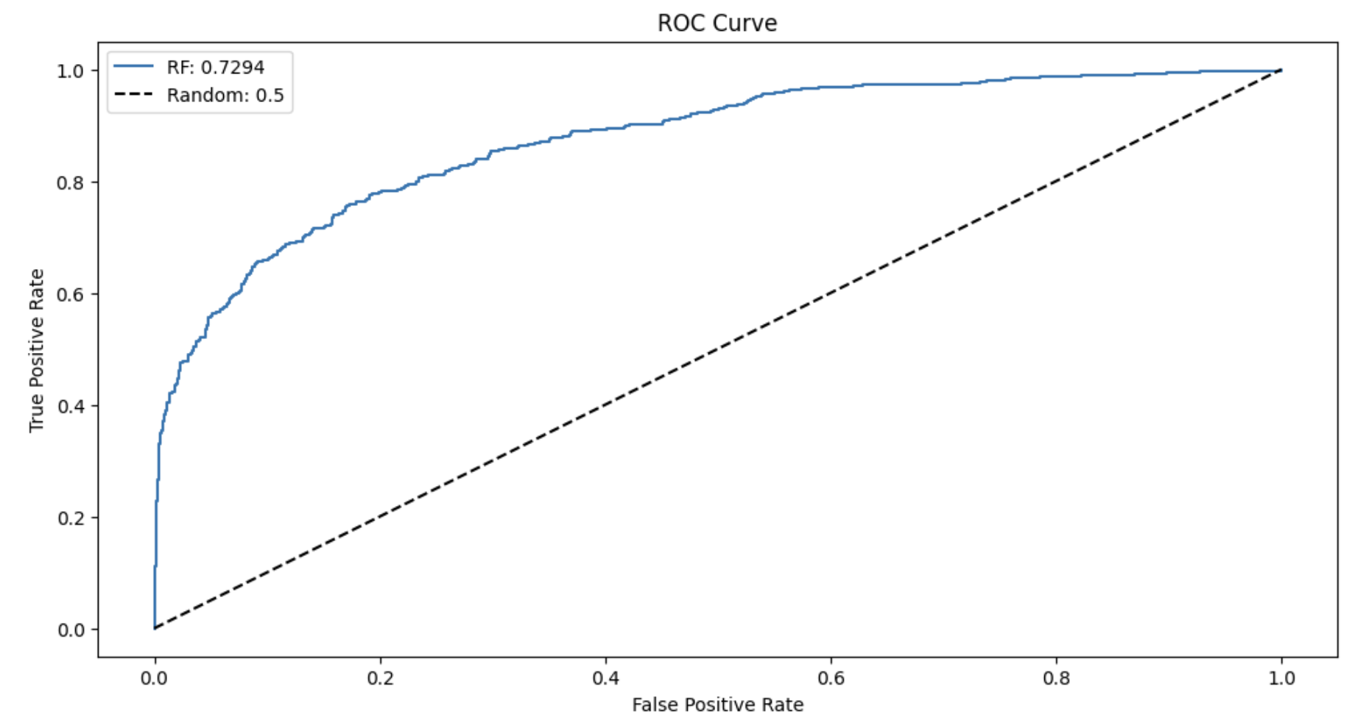
Results
(on test set)
-> Using Random Forest Classifier

Slide 19
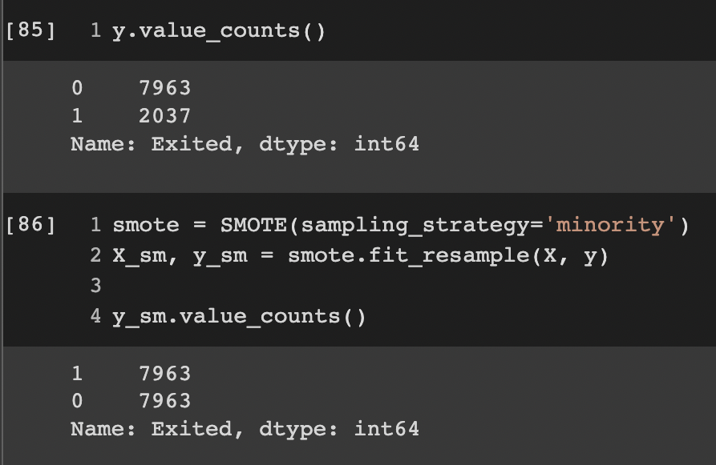
SMOTE
(Synthetic Minority Oversampling Technique)
Code snippet showing the balancing of data using SMOTE
SMOTE is an oversampling technique where the synthetic samples are generated for the minority class. This algorithm helps to overcome the overfitting problem posed by random oversampling. It focuses on the feature space to generate new instances with the help of interpolation between the positive instances that lie together.

Slide 20
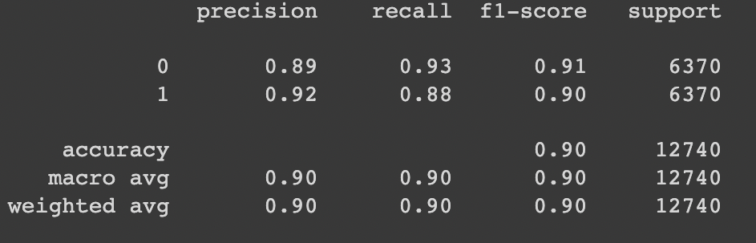
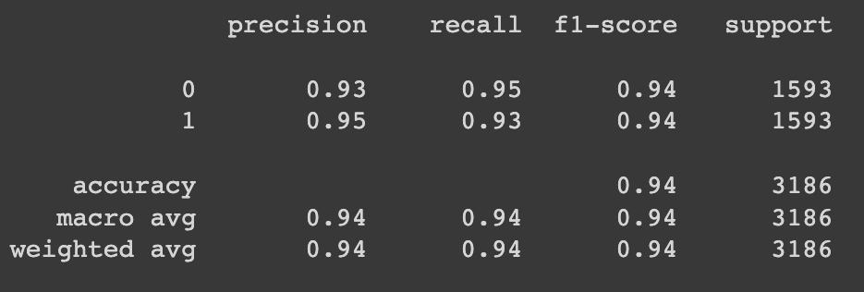
Results
(after SMOTE)
On train Set
-> Using Random Forest classifier
On Test Set

Slide 21
Limitations
We only have 10000 rows in the dataset so more data points could be added
While generating synthetic examples, SMOTE does not take into consideration neighboring examples can be from other classes. This can increase the overlapping of classes and can introduce additional noise
Finer hyperparameter tuning

Slide 22
Conclusion
80% accuracy is found using Random Forest Classifier
Using SMOTE, the accuracy significantly from 80% to 94%

Slide 23
REFERENCES
Supervised Machine Learning - Andrew Ng
Kaggle Churn Modelling Dataset
Advanced Learning Algorithms - Andrew Ng
Learning SVM - MIT OCW
Scikit-Learn Tutorial: Machine Learning in Python Examples
Machine Learning Specializat

